Slide 1
Environmental Planning subcommittee
Brooks Andrews, Chair
Meeting #2
07.30.20

Slide 2
Environmental Sub Committee Agenda
Role Call 5:00-5:05pm
Review of Agenda 5:05-5:10pm
Proposed Sub Committee Structure 5:10-5:25pm
Feedback 5:25-5:40pm
Proposed Assignments 5:40-5:50pm
Feedback 5:50-6:05pm
Next Steps 6:05-6:10pm
Feedback 6:10-6:20pm
Open Input Session 6:20-6:30pm
Close 6:30pm

Slide 3
Environmental Planning Structure
Land Use Planning
Environmental Justice
Sea/River Level Rise – Coastal Surge, Extreme Tides | Extreme Precipitation Events and Rain Pattern | Mean Temperature Increase and Heat Waves
Resilient Shorelines | Shoreline Protection | Green Infrastucture
Dune Preservation | Wetland Restoration and Preservation | Pavement Use and Design
Wetland Restoration and Preservation | Stormwater Management And Water Quality | Green House Gas Mitigation
Tributary Restoration and River Dredging Mitigation | Tree Canopy Preservation and Expansion | Tree Canopy Preservation and Expansion

Slide 4
Feedback

Slide 5
Proposed Assignments
Land Use Planning – Bill Bishop and Mark Middlebrook
Environmental Justice – Ashantae Green and Todd Sack
Sea/River Level Rise – Coastal Surge, Extreme Tides | Climate Change - Extreme Precipitation Events and Rain Pattern | Climate Change - Mean Temperature Increase and Heat Waves
Steve Swann | Adam Hoyles | Adam Bosenblatt
Dr. Quinton White | Joshua Rosenberg | Leslie Pierpont
Kevin O’Halloran | Patrick Krechowski | J. Logan Cross
Guillermo Simon | James Richardson | Shannon Blankinship

Slide 6
Feedback

Slide 7
Next Steps
Consolidate Input (Sub Committee Structure and Assignments)
Establish Working Protocol
Confirm Timetable for Future Meetings

Slide 8
Feedback

Slide 9
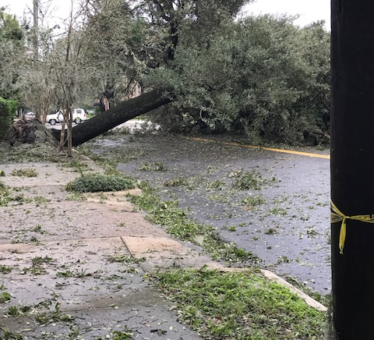
Open Input Session

Slide 10
Close

